Slide 1
SAPOL Crime Analysis 2013 - 2022
A Visual Overview of Violent Crime

Slide 2
Presentation INFORMATION
01
02
03
Intro to the Project
Mapping the Data
Seasons Beatings?
04
05
Pandemic Matters?
Compare the worst
Intro to Team, Dataset and fields
Mapped visualisation of the Data
Do particular seasons have more of particular crimes?
Has COVID changed crime trends?
What can be seen by Comparing the two worst postcodes?

Slide 3
01
Introduction to the Project
Intro to the Team, Dataset and Fields

Slide 4
Group 1
Andy Newman
Clinton Idehen
Nathan Teakle
Tim Cook

Slide 5

Project Goal
Analyse the SAPOL Crime Data for patterns and trends, and statistical profiles of some of the areas with the highest number of crimes committed.
This visualisation should be viewed in conjunction with the Summary Document

Slide 6
SAPOL Crime Data
Available in financial years, we selected 2013 - 2022
800,000+ rows of crime data by suburb and year
3 Crime Levels:
Offence Level 1: ‘Offences against the Person’, ‘Offences against property’
Offence Level 2: 'ACTS INTENDED TO CAUSE INJURY' 'ROBBERY AND RELATED OFFENCES' 'OTHER OFFENCES AGAINST THE PERSON' 'SEXUAL ASSAULT AND RELATED OFFENCES' 'HOMICIDE AND RELATED OFFENCES'
Offence Level 3: 'Common Assault' 'Serious Assault not resulting in injury' 'Blackmail and extortion' 'Threatening behaviour' 'Assault police' 'Abduction, harassment and other offences' 'Other acts intended to cause injury' 'Serious Assault resulting in injury' 'Aggravated sexual assault' 'Non-aggravated sexual assault' 'Non-assaultive sexual offences' 'Dangerous or negligent acts' 'Aggravated robbery' 'Non-aggravated robbery' 'Other homicide and related offences' 'Murder'
Some crime types including sexual assault are not allocated to a post code, so these will be excluded from some analysis.
Added analysis fields for Month and Year of offence.
https://data.sa.gov.au/data/dataset/crime-statistics

Slide 7
02
Mapping the Data
Mapped visualisation of the Data

Slide 8
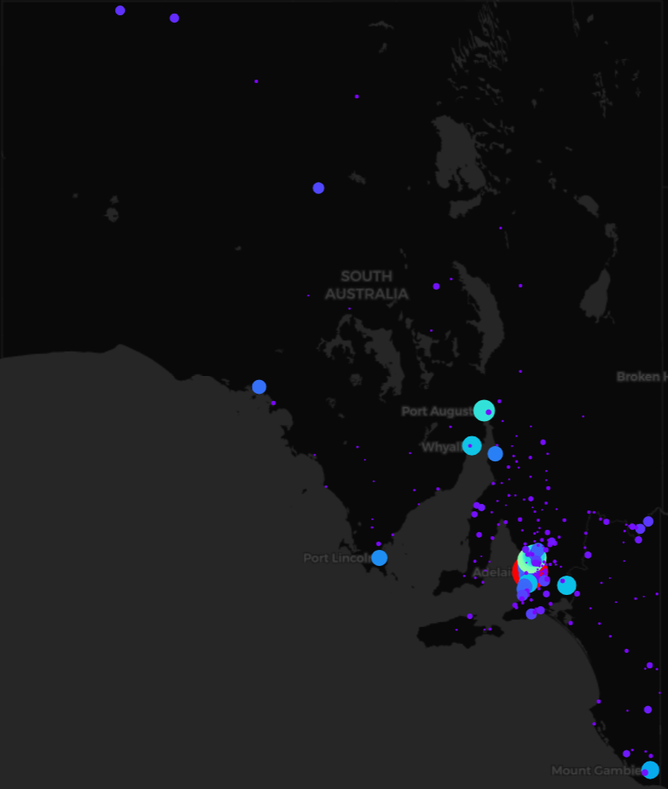
High Level Map
All crimes in SA in last 10 years combined and mapped by Postcode
Patterns show most of the highest crime counts in Metro
The bigger the dot and the brighter the color the higher the number of crimes committed during the period of our dataset.

Slide 9
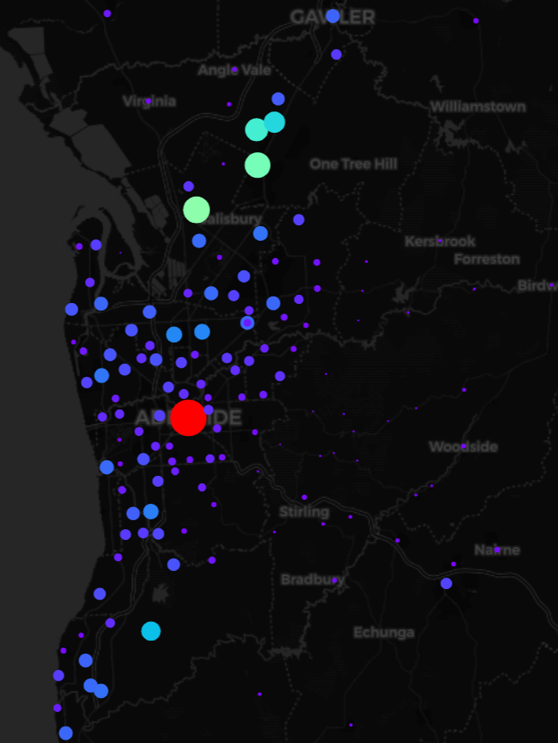
Metro Map
All crimes in SA in last 10 years combined and mapped by Postcode
Patterns show most of the highest crime counts in Metro

Slide 10
Highest Numbers of REPORTED CRIMES
5000 - 14,579
5108 - 7,656
Adelaide & Mile End
Paralowie, Salisbury Downs, Salisbury North
5112 - 7,029
5113 - 5,614
Elizabeth, Elizabeth East, Elizabeth Grove, Elizabeth South, Elizabeth Vale, Hillbank
Davoren Park, Edinburgh North, Elizabeth Downs, Elizabeth North, Elizabeth Park

Slide 11
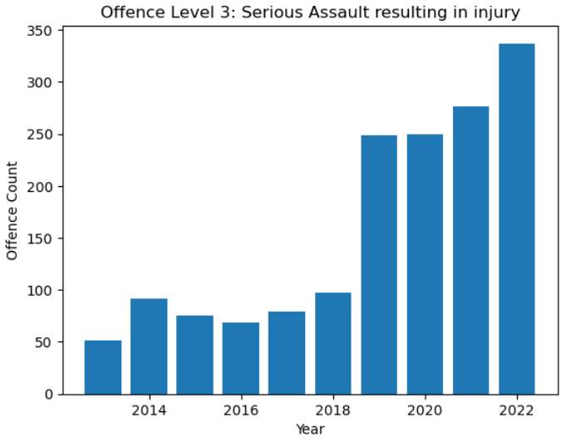
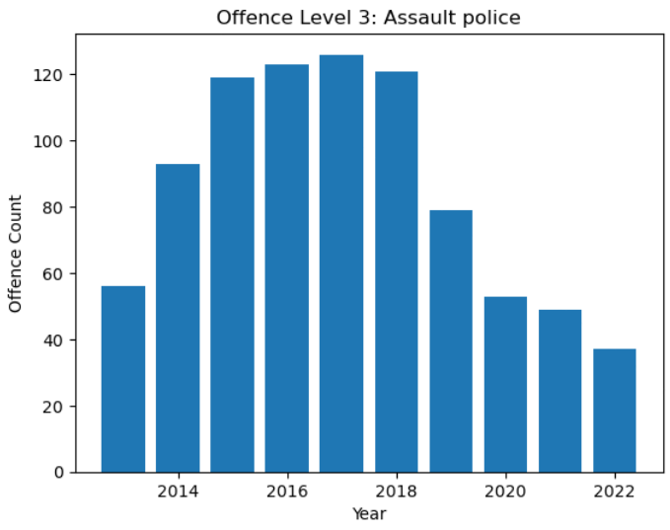
Postcode 5000 Trends

Slide 12
Contrast in crimes
Reduction in Assaults on Police
Increase in Serious Assaults with Injury
Far less assaults against Police and a rise in Violent Assaults resulting in Injuries could suggest that an increased Police presence is required in the 5000 Postcode, and likely could be targeted to the peak times.

Slide 13
03
Seasons BEATINGS?
Do crime patterns change according to seasons?

Slide 14
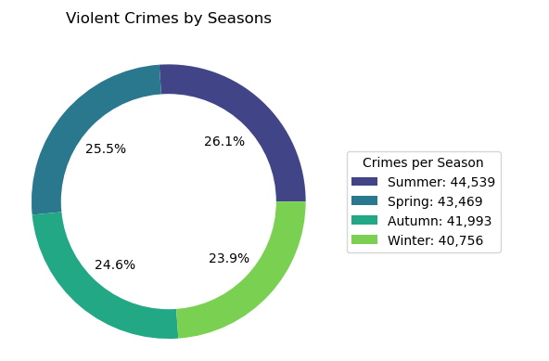
Violent Crimes by Seasons
All violent crimes over the last 10 years divided by Season of the year.
As temperatures rise during the Seasons, there is a corresponding increase in crime, on a season-to-season basis the increase is marginal.
However the increase in crime from Winter to Summer is more noticeable at roughly 9.28%.

Slide 15
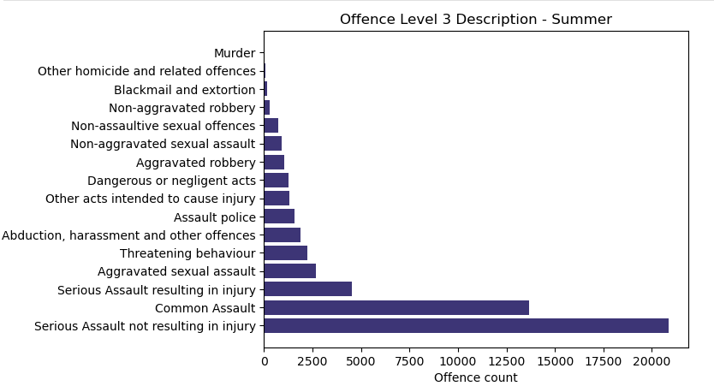
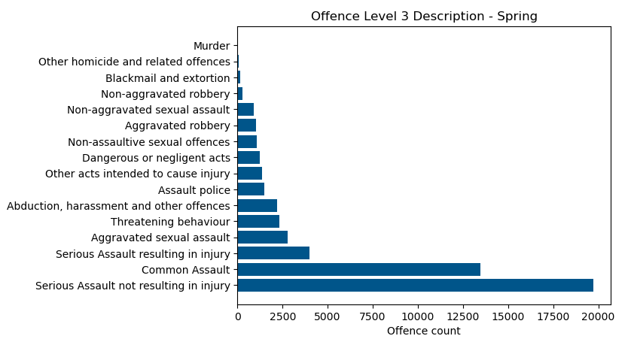

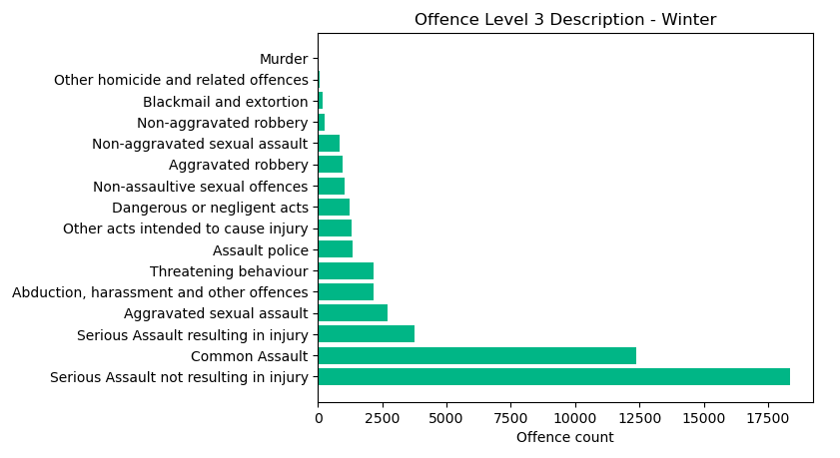
Additional Findings
All Crimes by Seasons

Slide 16
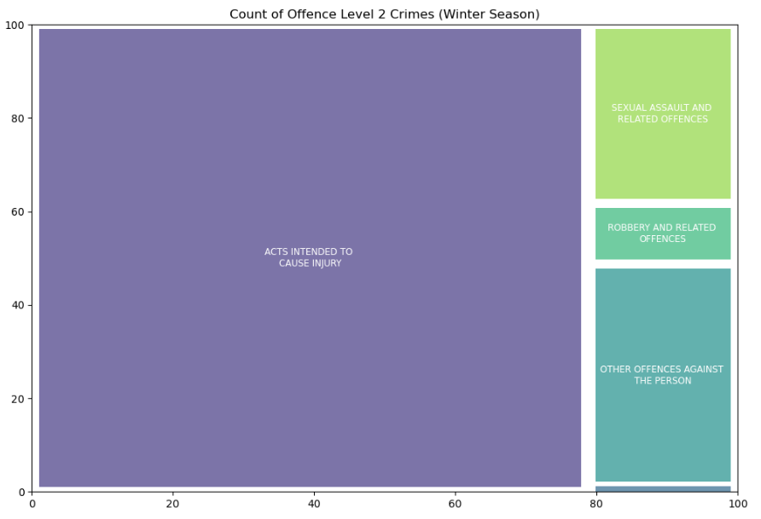
Treemap of Winter Crimes
As demonstrated in the previous slide, the dispersion of crime and the categories of offences committed exhibit a relatively consistent pattern across all seasons.
Consequently, I have chosen to focus on one particular season - Winter - and create a treemap visualisation to more effectively illustrate the distribution of Level 2 offences during Winter.

Slide 17
04
PANDEMIC Matters?
Has COVID had an effect on Crime Trends?

Slide 18

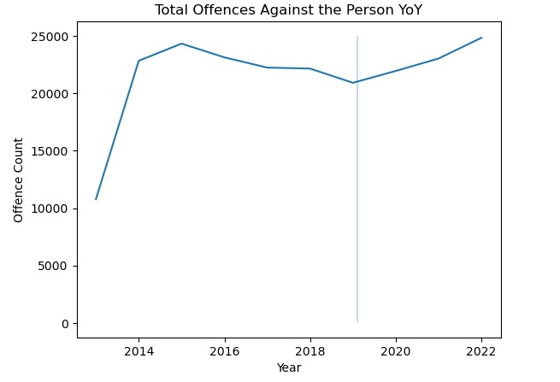
Total violent crime trend against people since mid 2013. COVID reference line is placed after the 2019 data point. The time when covid started to be taken seriously in Australia. Deeper analysis can be found in the Summary Document.
COVID reference line

Slide 19
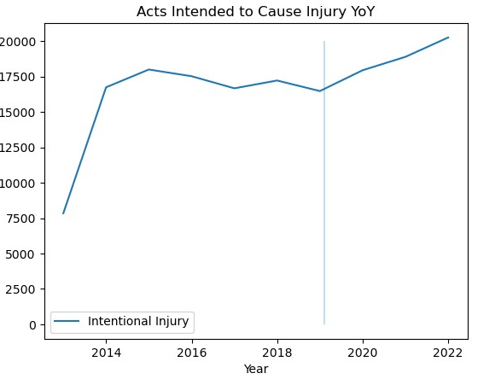
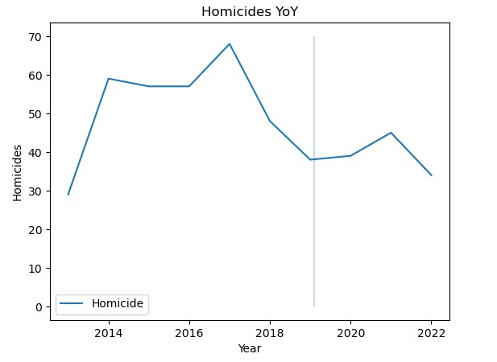
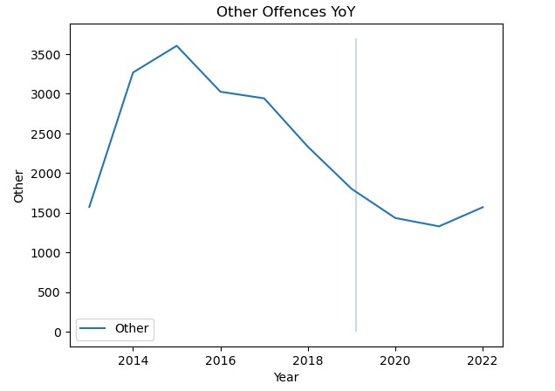
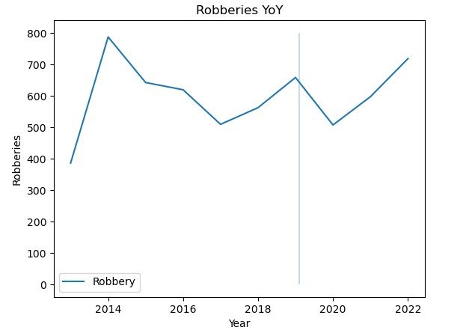
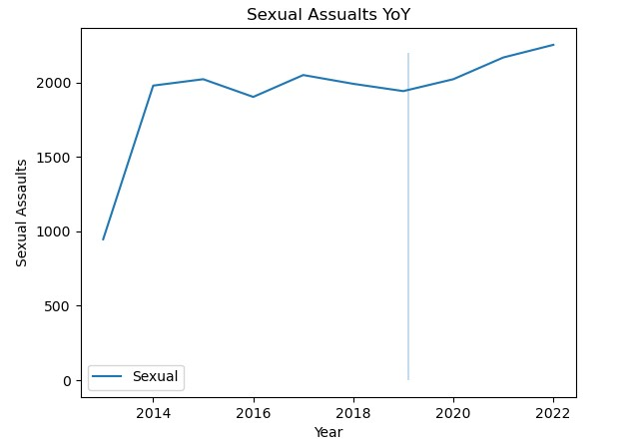
If total numbers of violent crime has increased during COVID, has the increase been across the board or has it been confined to certain offences?

Slide 20
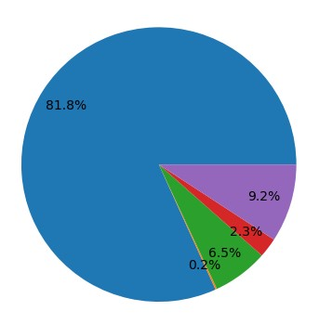
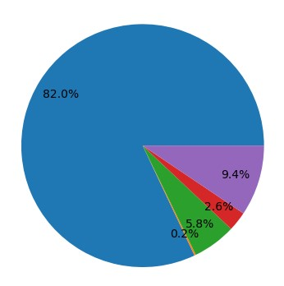
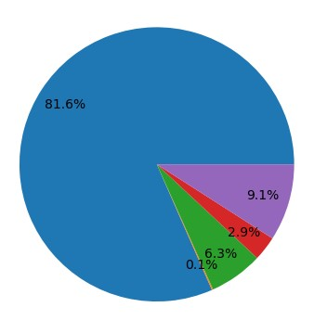
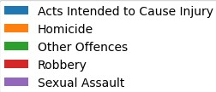
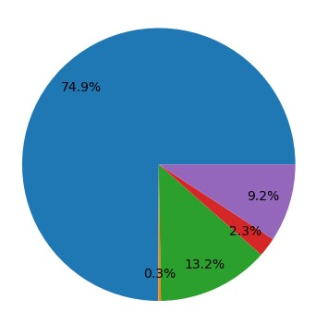
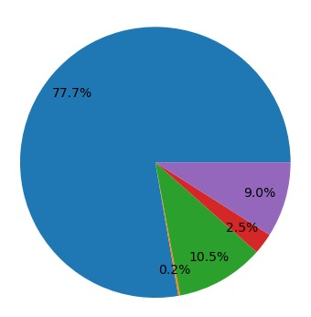
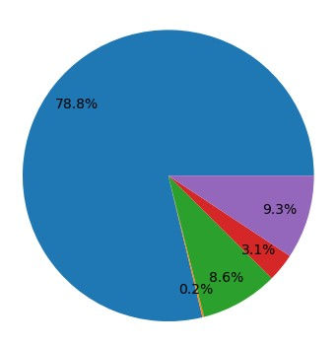
Another way to visualise the data.
Was there a noticeable change in the crime ‘spread’ after COVID?
3 Years Post - COVID
2020
2021
2022
3 Years Pre - COVID
2017
2018
2019

Slide 21
05
Compare the WORST
What can be seen by Comparing the two worst postcodes?

Slide 22
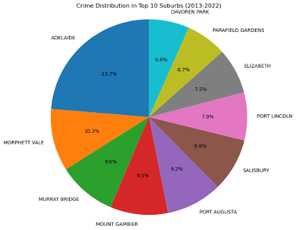
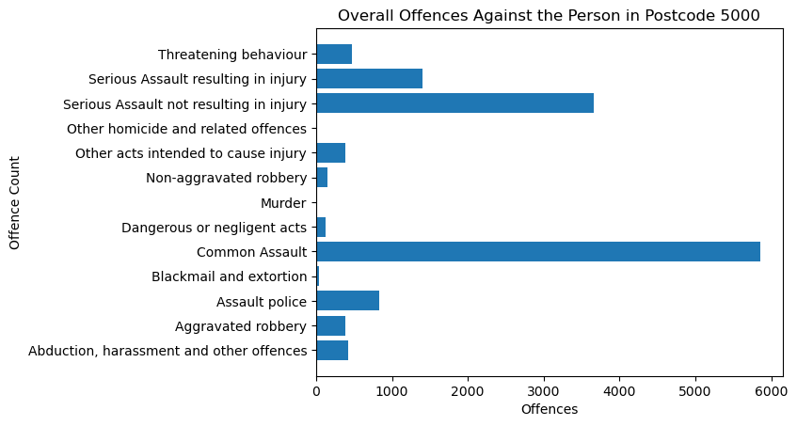

Slide 23

CONCLUSIONS
Police officer allocations in the 5000 Postcode should be reviewed and increased with an aim to steming the increase in assaults ending in injuries.
During the Summer months, it is recommended that the number of active-duty police officers be increased proportionally to match the observed increase in crime rates associated with warmer weather.
The COVID pandemic definitely seems to have contributed to a rise in violent crime after years of trending down.
Adelaide has a significantly larger transient population than other suburbs, the higher crime count might be influenced by a larger pool of potential perpetrators and victims.

Slide 24
Thanks!

